Slide 1
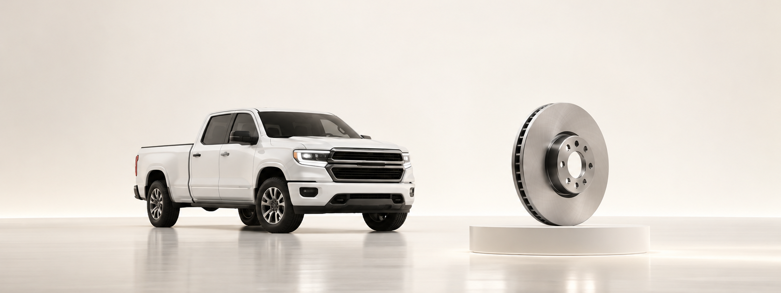
One plan. Three moves.
UMI target, channel capture and the parts data needed to act.
ISZE / UMI Sales Review Prototype
source: UMI Sales Review FY2027
Notes:
[Sources]
- Source deck: ISZE_UMI_Sales_Review_FY2027_ModeA_only.pptx. UMI review title and meeting context: lines 23-25.
- FY2027 YTD and budget/LY figures: lines 55-65.
- Commercial parts performance: lines 70-80.
- Category movers: lines 85-150.
- GPS, service-parts coverage, IDS and fleet/target data: lines 176-235 and 240-276.
- SPA and Sales-to-Dealer ask: lines 286-345.

Slide 2
€875k
FY2027 YTD sales are slightly ahead of budget, but below last year.
vs budget
vs LY
+2%
-14%
ISZE / UMI Sales Review Prototype
source: UMI Sales Review FY2027
Notes:
[Sources]
- Source deck: ISZE_UMI_Sales_Review_FY2027_ModeA_only.pptx. UMI review title and meeting context: lines 23-25.
- FY2027 YTD and budget/LY figures: lines 55-65.
- Commercial parts performance: lines 70-80.
- Category movers: lines 85-150.
- GPS, service-parts coverage, IDS and fleet/target data: lines 176-235 and 240-276.
- SPA and Sales-to-Dealer ask: lines 286-345.

Slide 3

The cleanest opportunity is service retention.
Start with the gaps that dealers can understand.
Brake rotor
Air filter
12.0%
22.9%
network 60.4%
network 56.3%
IDS average
60.9%
GPS capture
54.2%
ISZE / UMI Sales Review Prototype
source: UMI Sales Review FY2027
Notes:
[Sources]
- Source deck: ISZE_UMI_Sales_Review_FY2027_ModeA_only.pptx. UMI review title and meeting context: lines 23-25.
- FY2027 YTD and budget/LY figures: lines 55-65.
- Commercial parts performance: lines 70-80.
- Category movers: lines 85-150.
- GPS, service-parts coverage, IDS and fleet/target data: lines 176-235 and 240-276.
- SPA and Sales-to-Dealer ask: lines 286-345.

Slide 4
Ask for less. Decide more.
Four customer commitments replace a long diagnostic meeting.
Meeting outcome
Target
Close Shell price hold
€3.05m
FY2027 extended
Pick first service-parts pilot
Return SPA counter-list
Data
monthly PN level
Share Sales-to-Dealer data
from Jan 2025
ISZE / UMI Sales Review Prototype
source: UMI Sales Review FY2027
Notes:
[Sources]
- Source deck: ISZE_UMI_Sales_Review_FY2027_ModeA_only.pptx. UMI review title and meeting context: lines 23-25.
- FY2027 YTD and budget/LY figures: lines 55-65.
- Commercial parts performance: lines 70-80.
- Category movers: lines 85-150.
- GPS, service-parts coverage, IDS and fleet/target data: lines 176-235 and 240-276.
- SPA and Sales-to-Dealer ask: lines 286-345.

